Slide 1
Wealth and consumption
Haichuan Zhang Peilin Wang Zhenyang Cui

Slide 2
Introduction
We wonder about do household consume more when their wealth increases?
We expect to identify a positive relationship between consumption and wealth by using 20 EU zone countries and Japan datasets to regress.

Slide 3
Definition
Wealth:
Fixed asset value: the worth of long-term physical assets owned by the household, such as a house, car, or land.
Stock market financial assets:instruments like stocks, bonds, mutual funds, and ETFs that individuals or institutions invest in through financial markets.
Employee compensation or income: total earnings an individual receives from employment,
Consumption is consumption of household(s).

Slide 4
Github
Link to Our project github: https://github.com/Graspp-25-Spring/graspp-25S-Wealth-Consumption

Slide 5
EU Datasets
Source: ECB(European Central Bank)
Description: Quarterly private consumption data
Countries: 20 EU zone countries
Time Series: ranges from April 1995 to December 2024

Slide 6
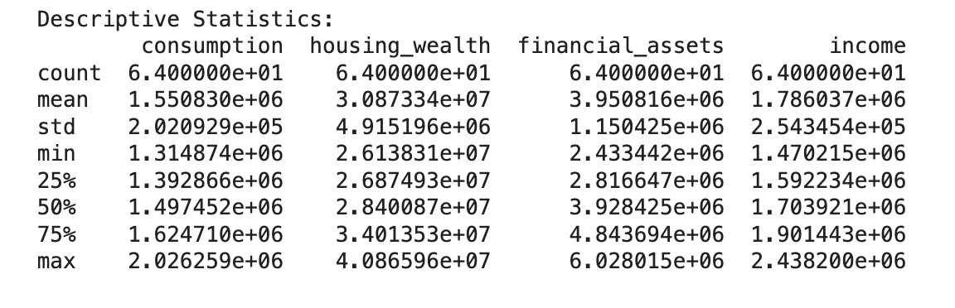
Descriptive Statistics EU
Indicator

Slide 7
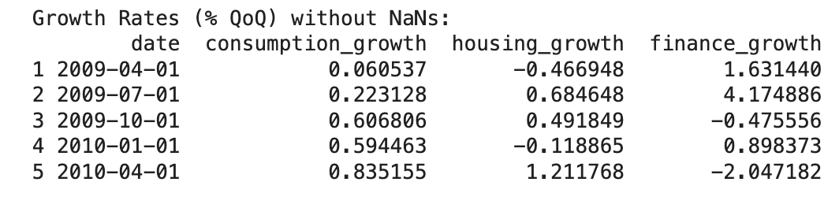
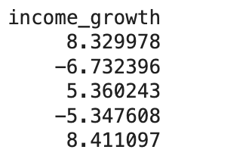
Descriptive Statistics EU
Growth Rate

Slide 8
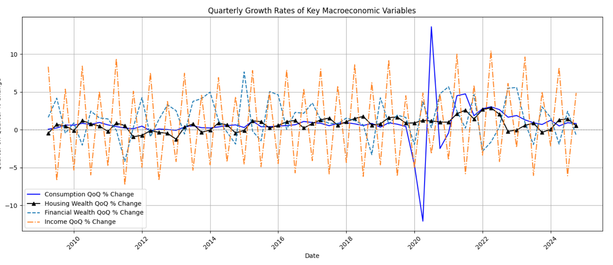
Visualization EU
Time Series Plot

Slide 9
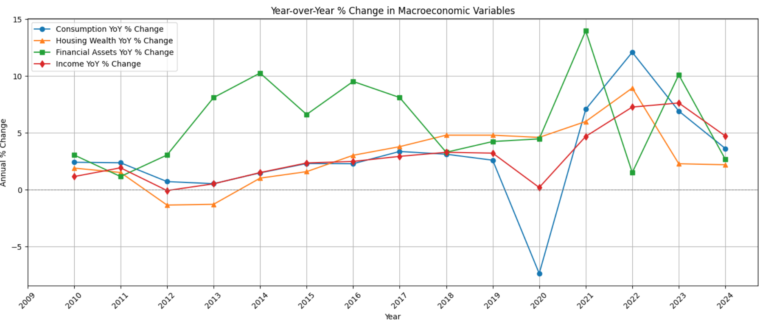
Visualization EU
Time Series Plot

Slide 10
Visualization EU
What can we get from these line charts
Quarter-on-Quarter Dynamics (Top Chart)
Year-over-Year Trends (Bottom Chart)
Implications:
The relationship between housing wealth and consumption growth, while present, appears more modest and lagged than that of financial assets.
These trends may reflect changes in wealth effects, savings behavior, or macroprudential responses across the EU.

Slide 11
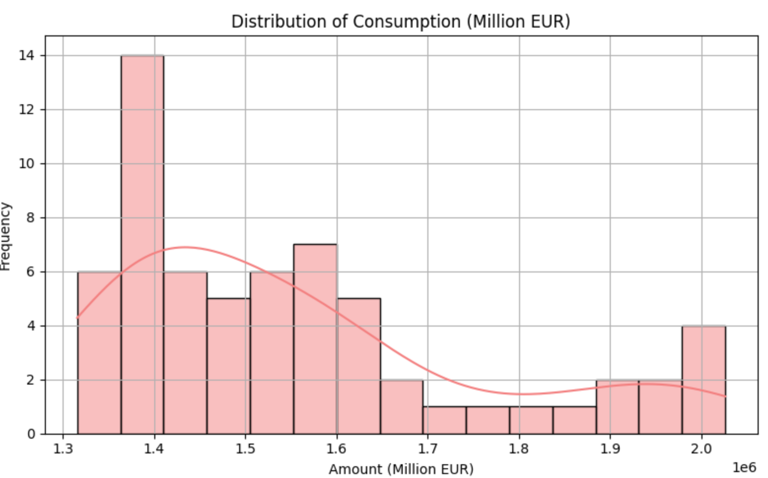
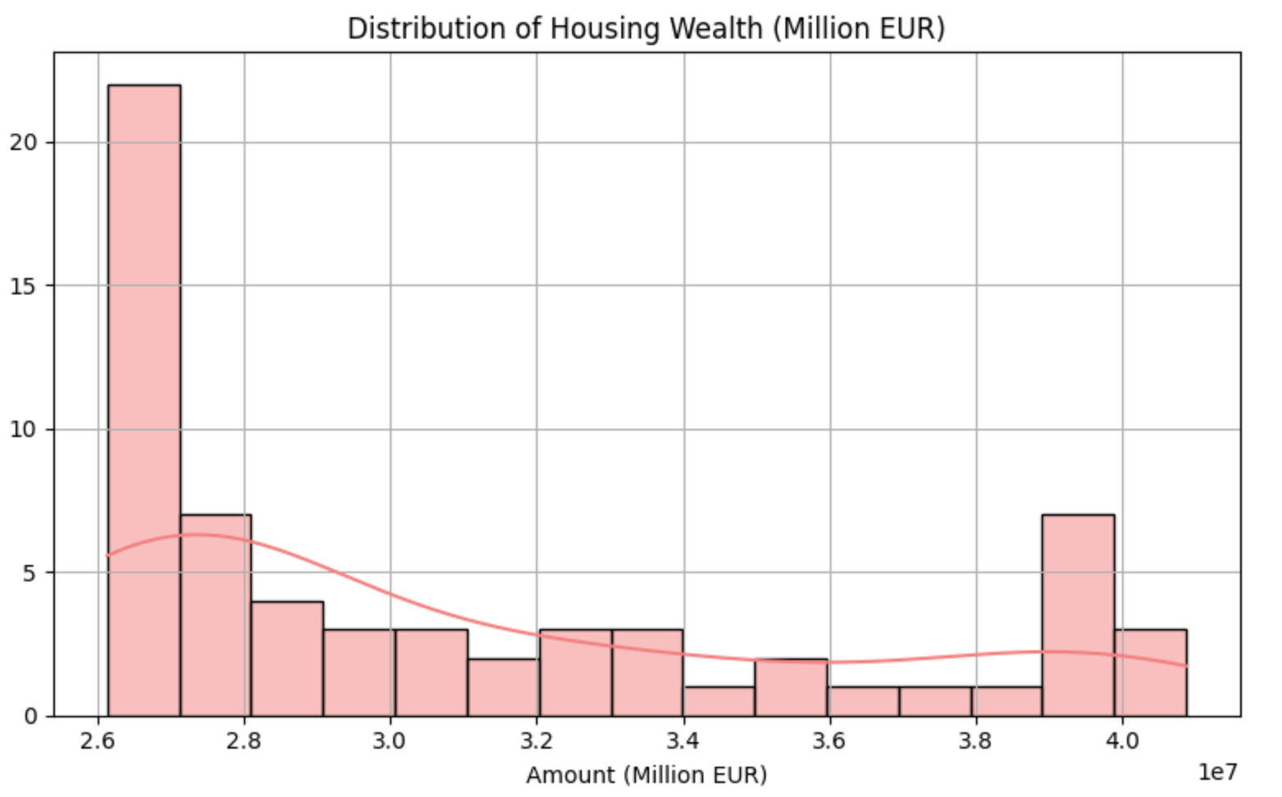
Visualization EU
Normality

Slide 12
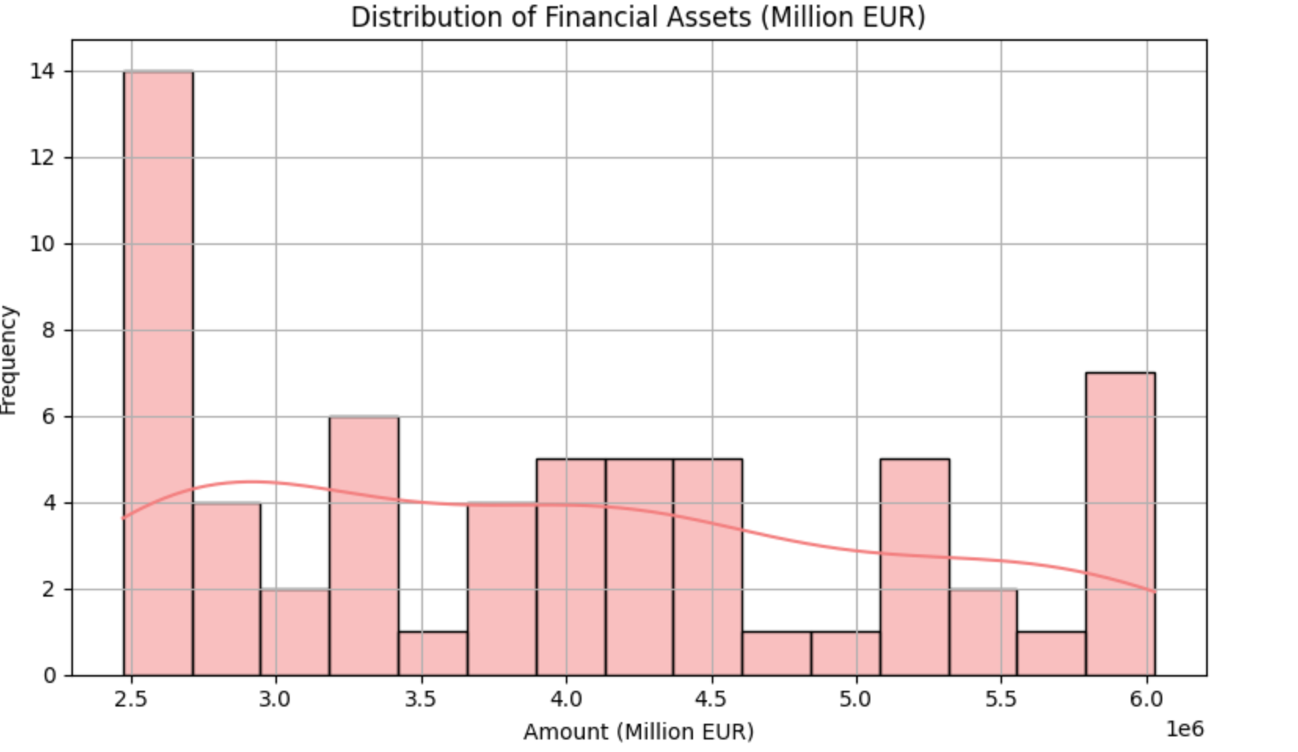
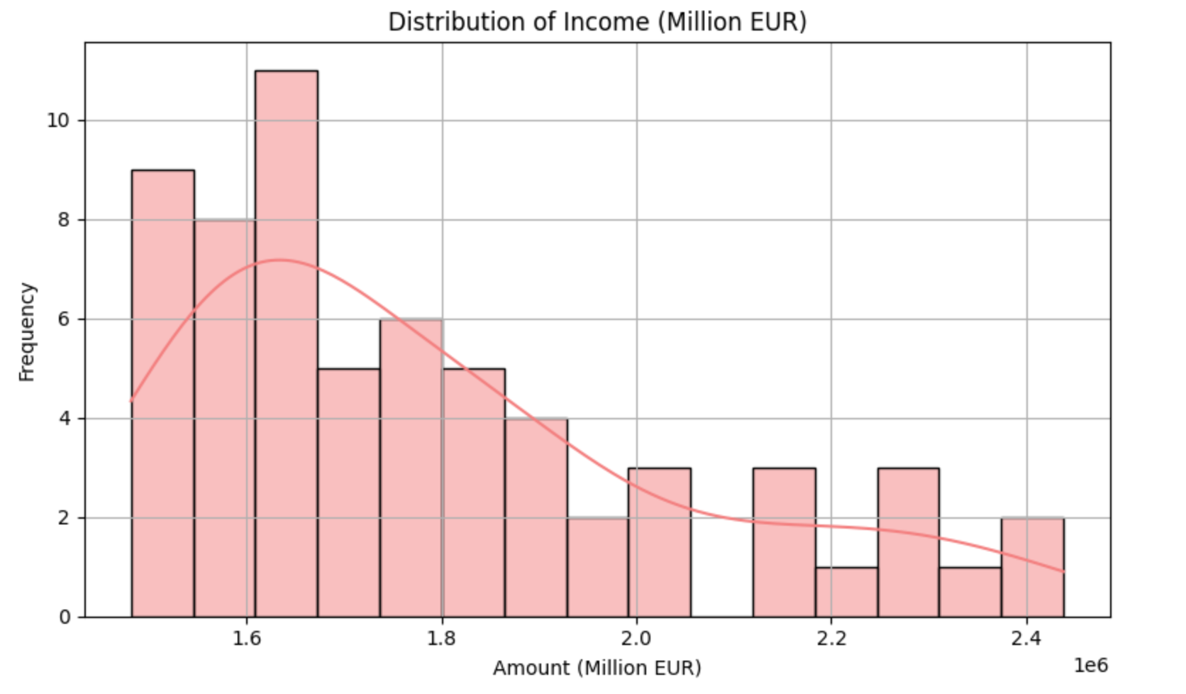
Visualization EU
Normality

Slide 13
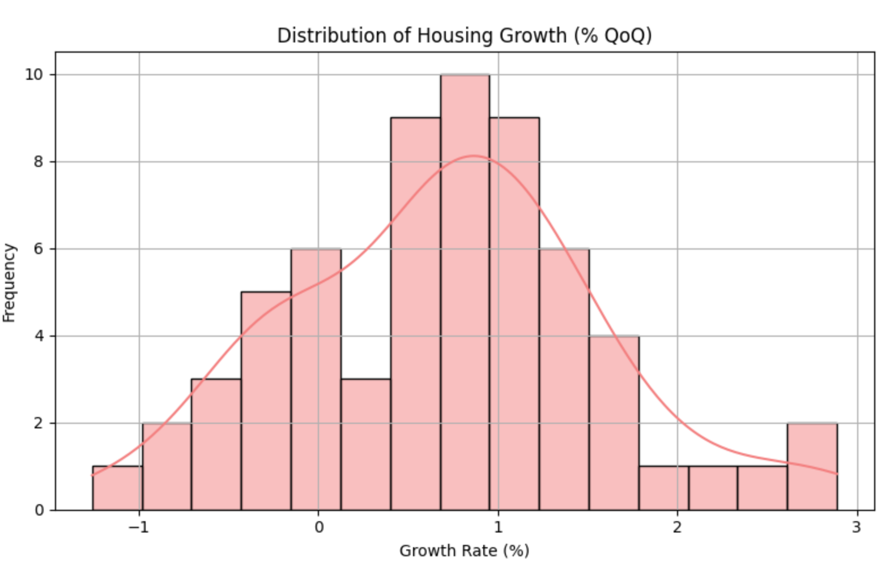
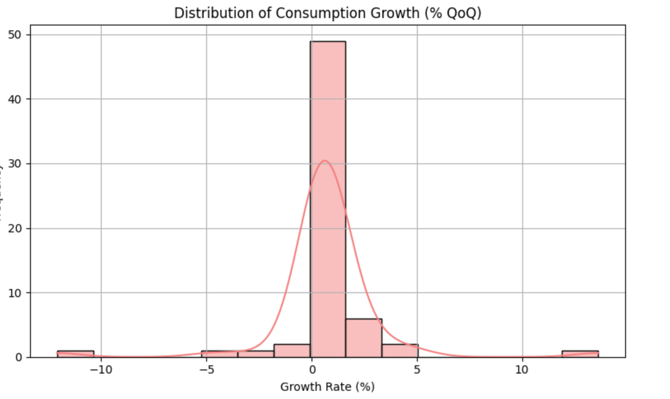
Visualization EU
Normality of growth rate

Slide 14
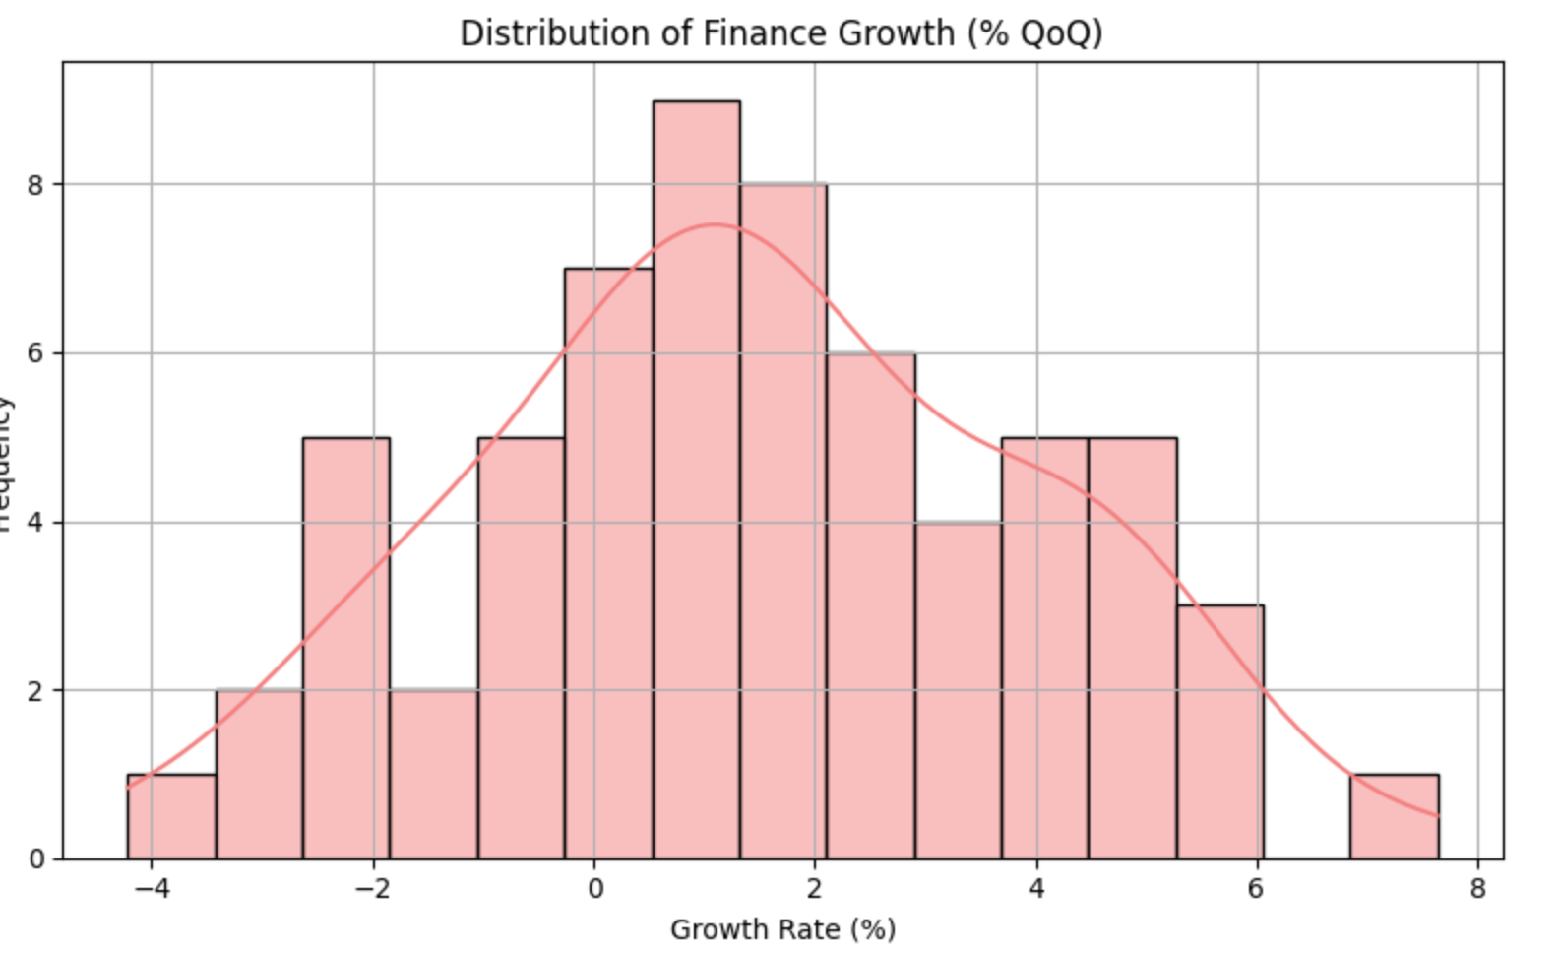
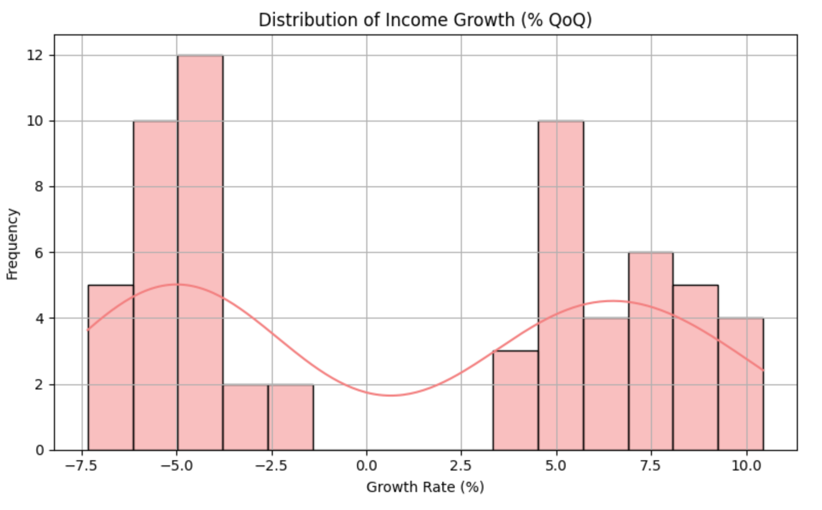
Visualization EU
Normality of growth rate

Slide 15
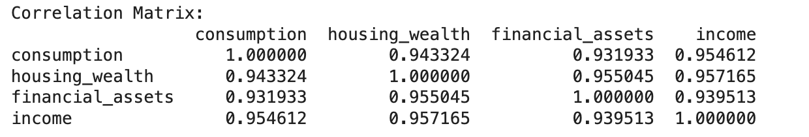
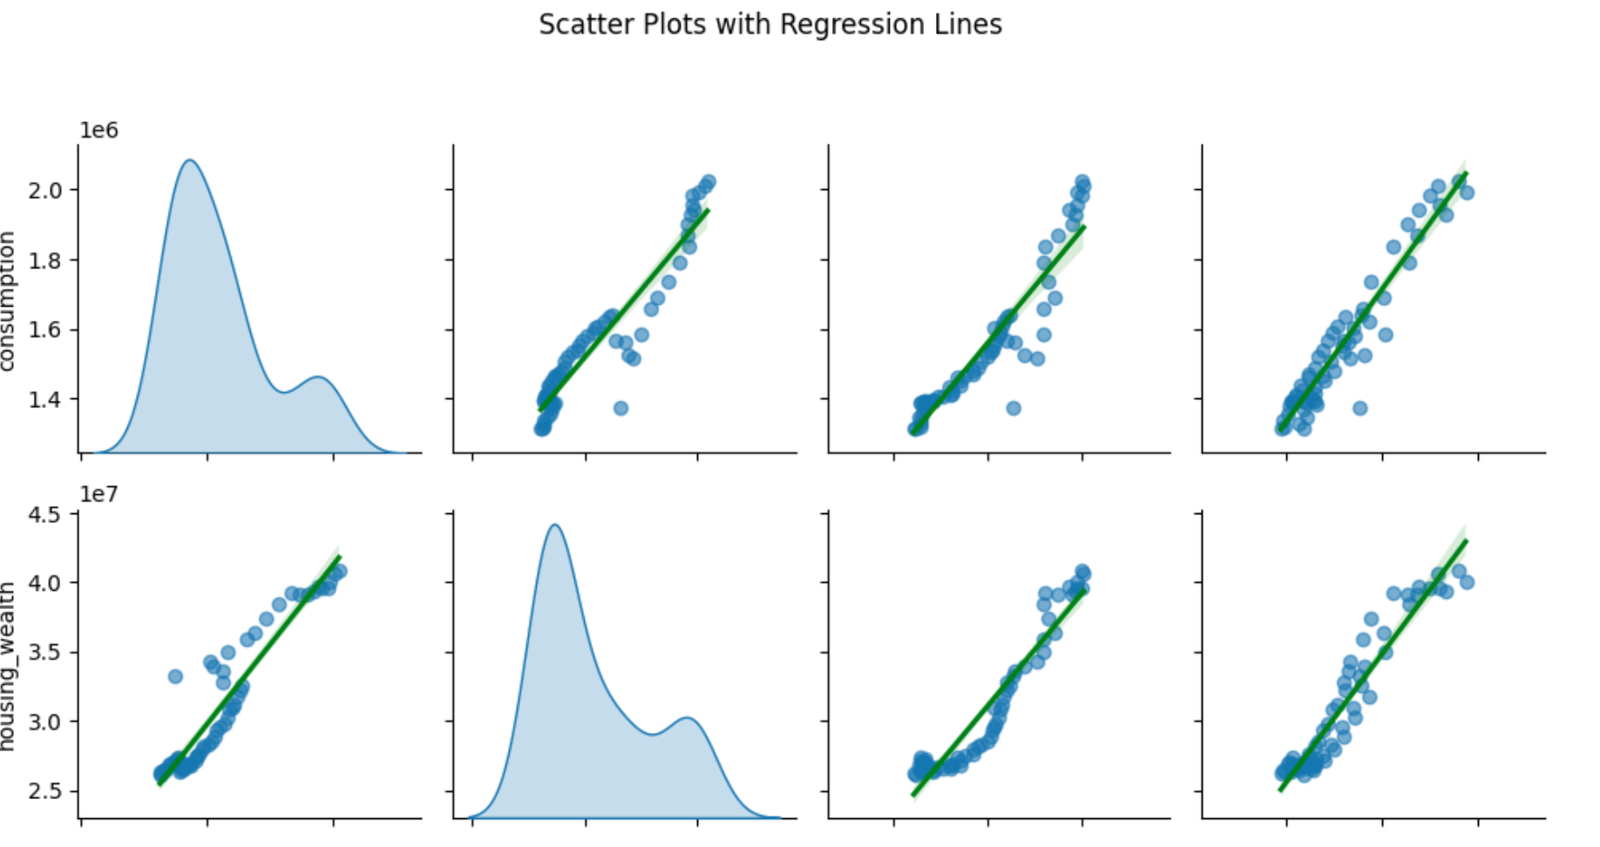
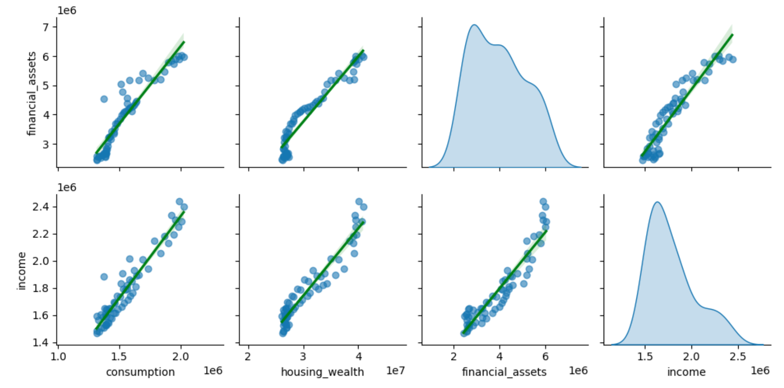
Visualization EU
Scatter Plot

Slide 16
Japan Datasets
Source: Cabinet Office Japan (内閣府) and Family Income and Expenditure Survey (e-Stat)
Description: Quarterly macroeconomic data for Japan
Time Series: 1994–2023

Slide 17
Japan Dataset
Consumption: Household consumption expenditure (from Family Income and Expenditure Survey - 家計調査)
Housing Wealth: Fixed assets (housing component) from National Accounts (SNA)
Stock Market Wealth: Household financial assets (specifically "stocks") from National Accounts (SNA)
Income: Compensation of employees from National Accounts (SNA)

Slide 18
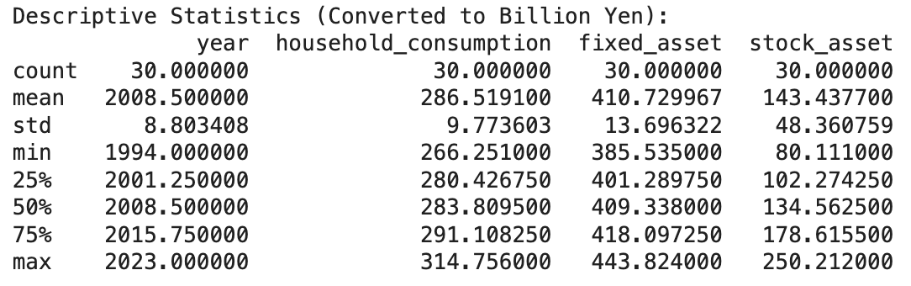
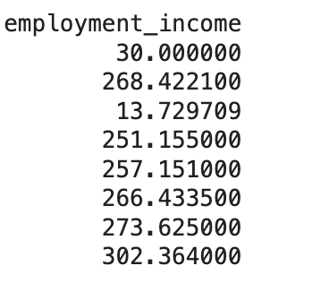
Descriptive Statistics Japan
Indicator

Slide 19
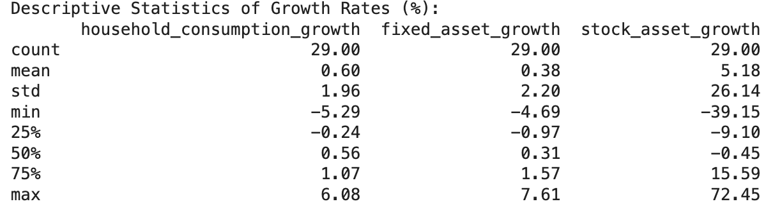
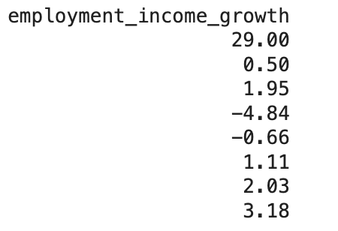
Descriptive Statistics Japan
Growth Rate

Slide 20
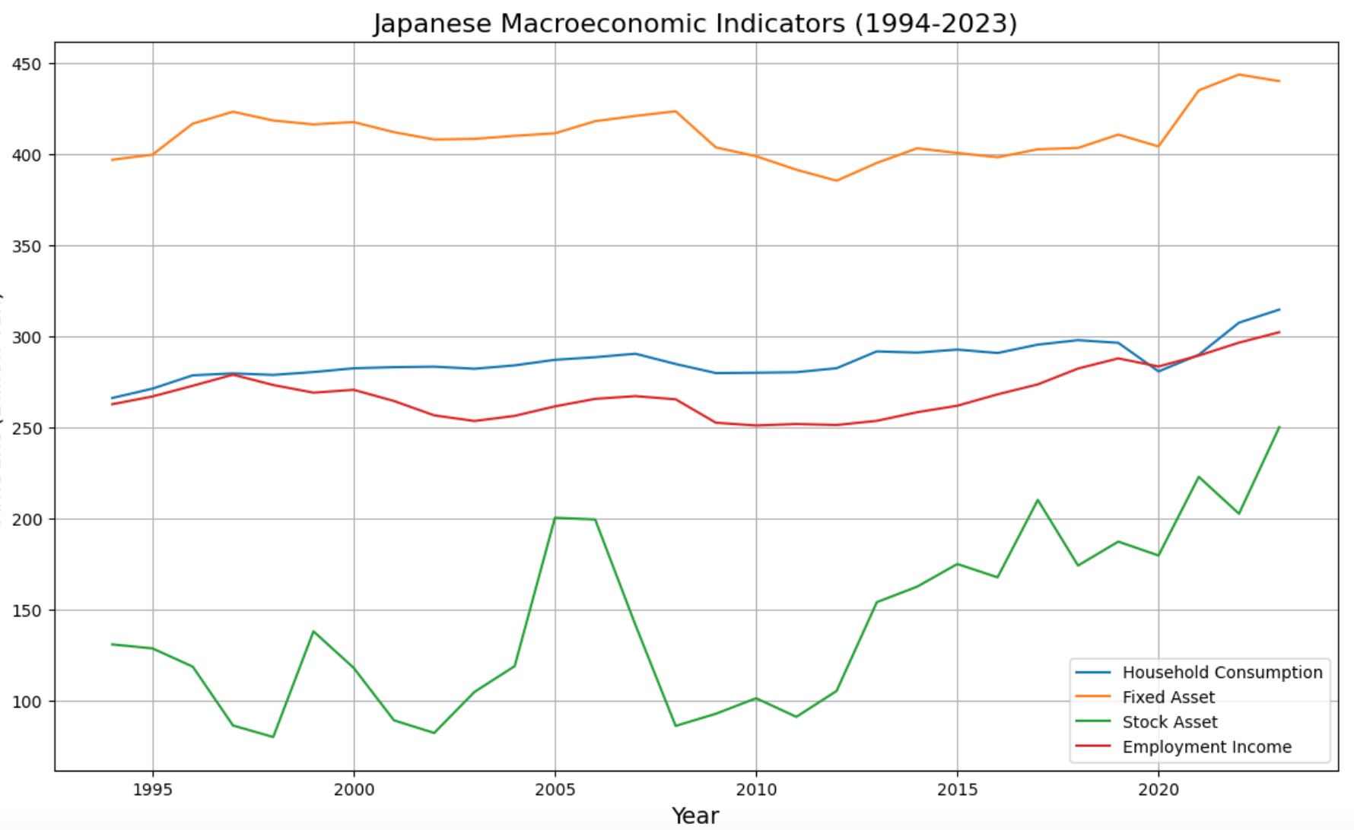
Visualization Japan
Time Series Plot

Slide 21
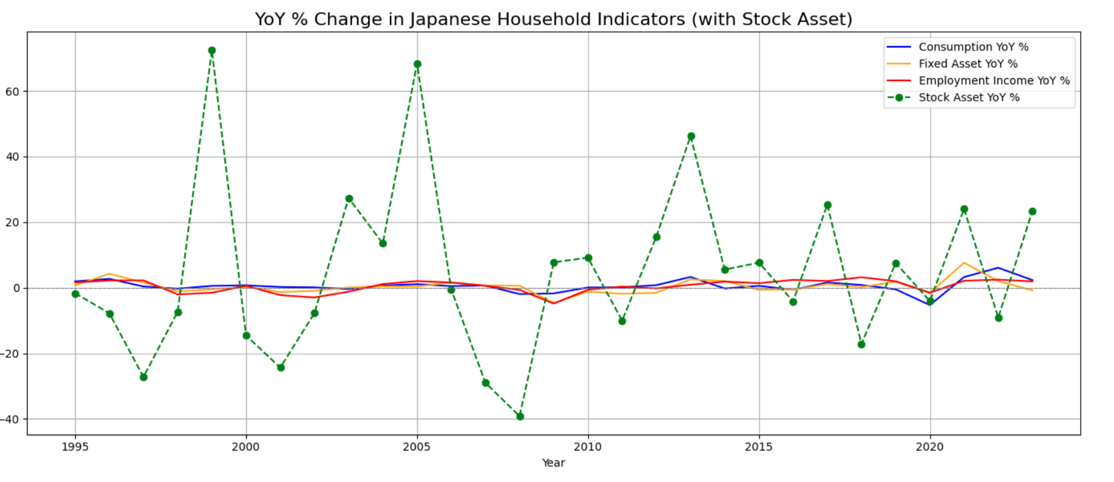
Visualization Japan
Quarter-on-Quarter % Change

Slide 22
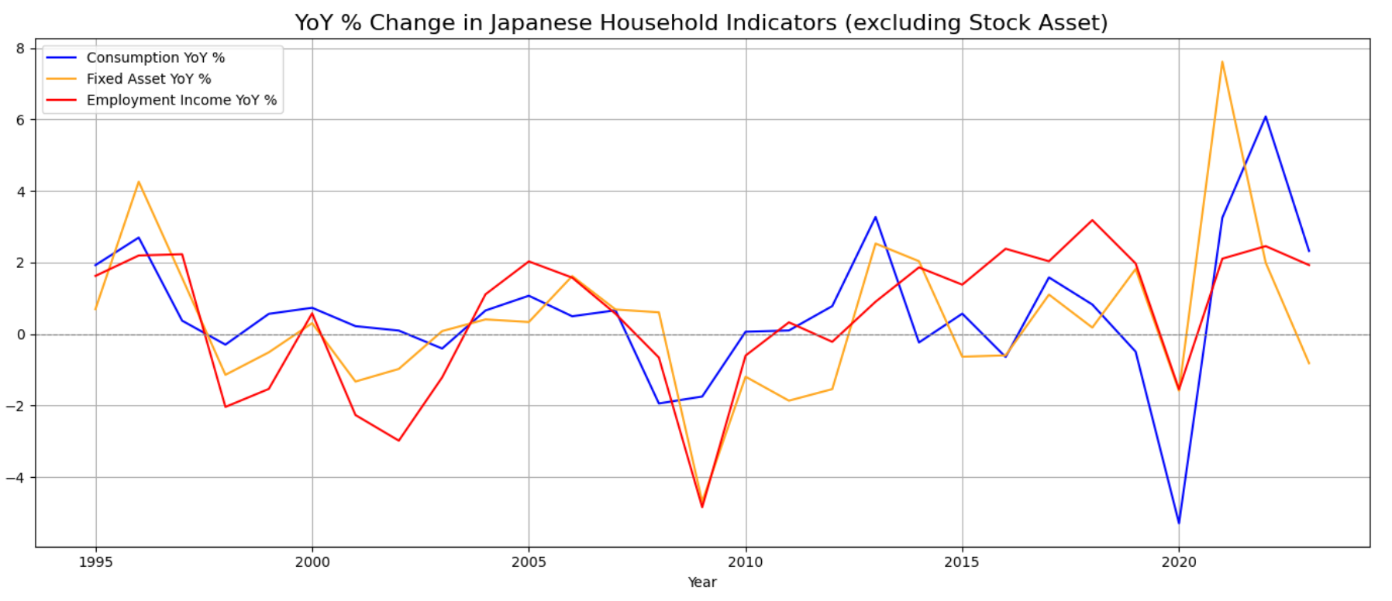
Visualization Japan
Quarter-on-Quarter % Change

Slide 23
Visualization Japan
Explain for the ecnomic shock
Post-Bubble Stagnation (Late 1990s)
2008 Global Financial Crisis
COVID-19 Pandemic (2020)

Slide 24
Visualization Japan
Implications:
Japanese consumer behavior is still strongly income-driven. Wealth effects (from asset appreciation) appear limited.
real estate as a safer household asset class.
financial markets are highly sensitive to global and domestic shocks
short-term policy success, but the sustainability of this recovery remains uncertain.

Slide 25
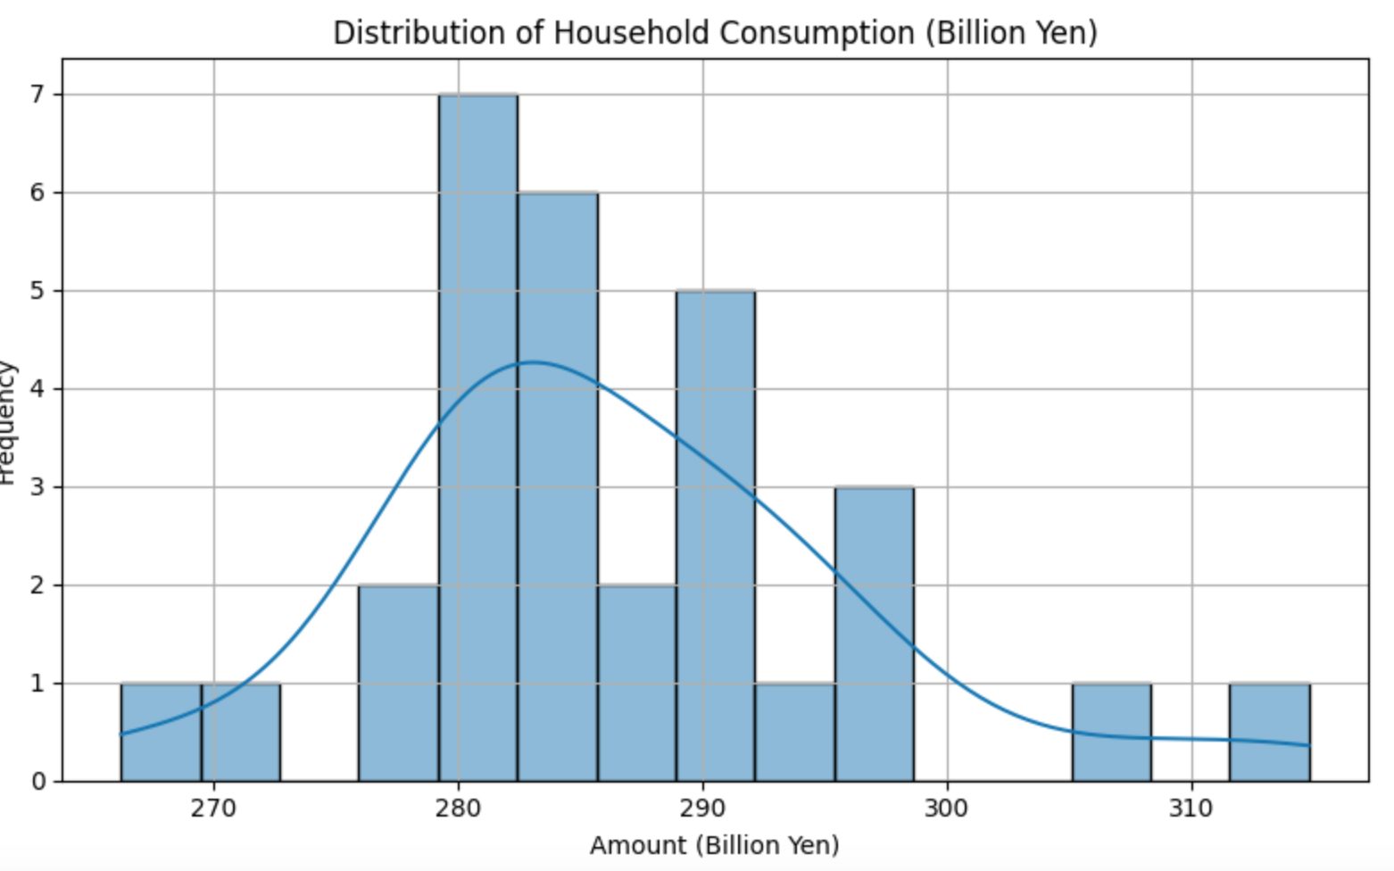
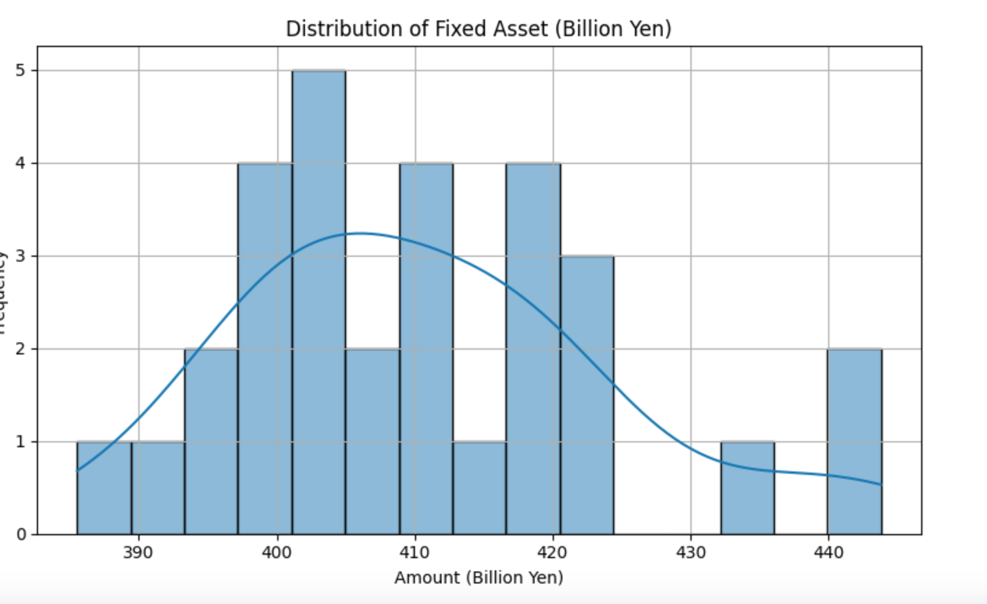
Visualization Japan
Normality

Slide 26
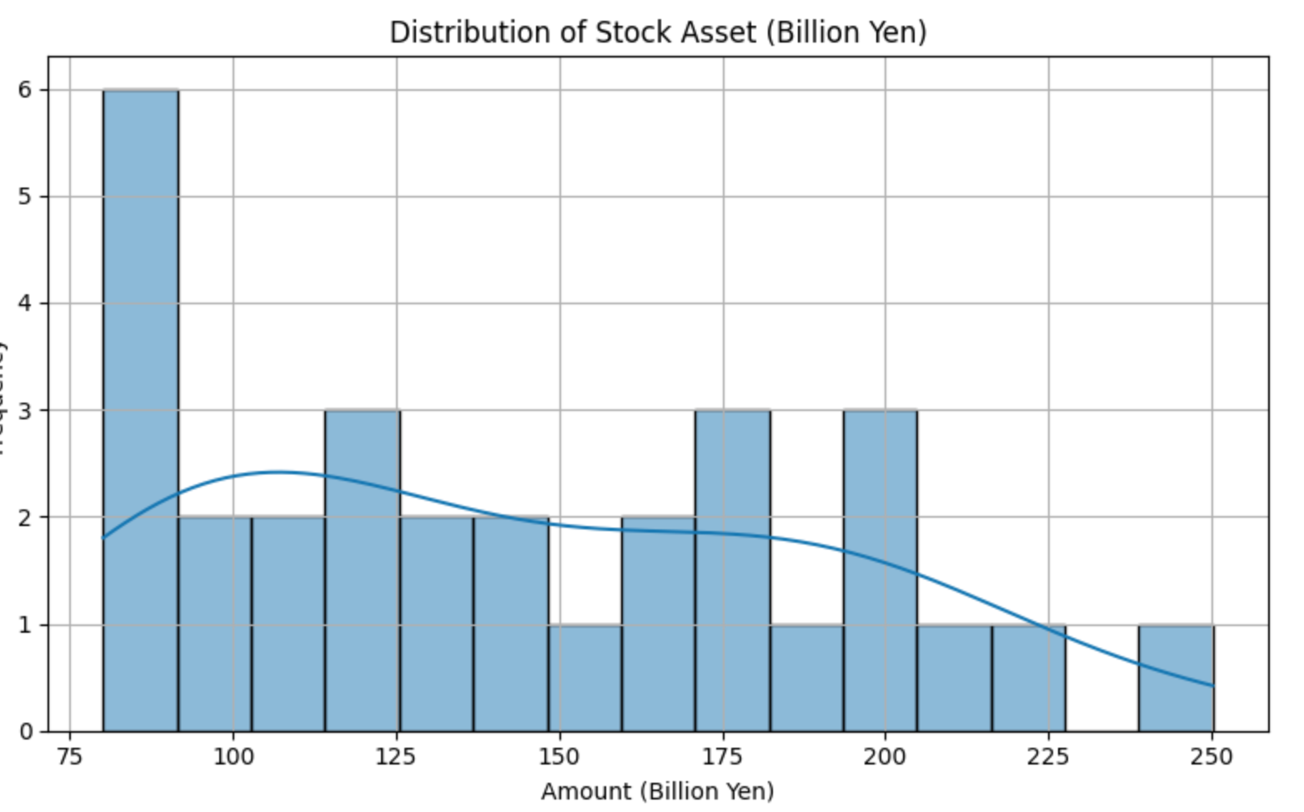
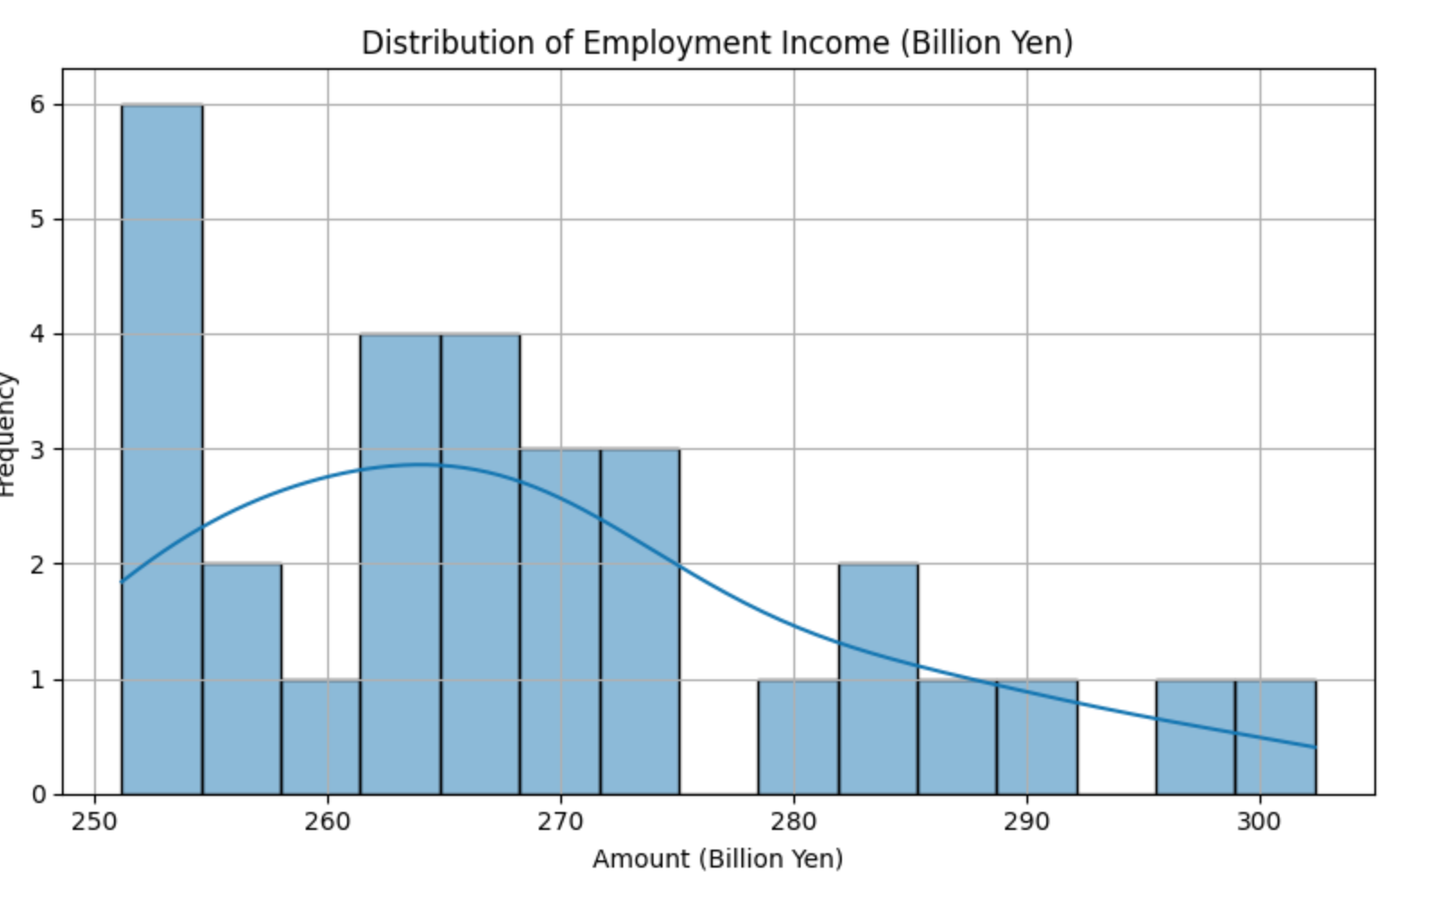
Visualization Japan
Normality

Slide 27
Visualization Japan
Normality:
Household Consumption:a generally stable level of household consumption with a few years of stronger spending.
Fixed Asset: fixed assets (mainly housing wealth) remained relatively steady over time, with moderate variation.
Stock Asset:occasional spikes in financial asset holdings, but most years show modest stock wealth.
Employment Income:labor income is relatively consistent across years, with a few outlier years of higher income likely due to economic upturns or wage policy changes.

Slide 28
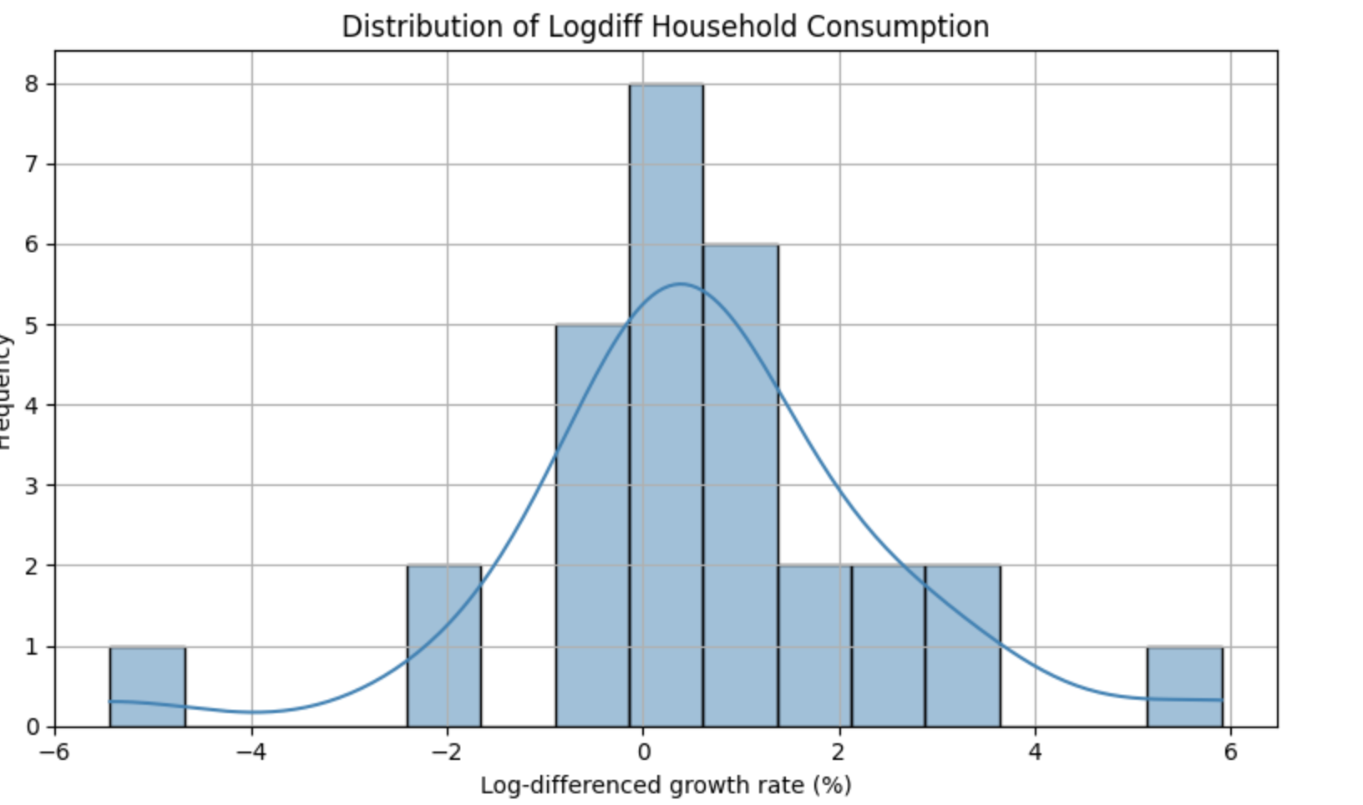
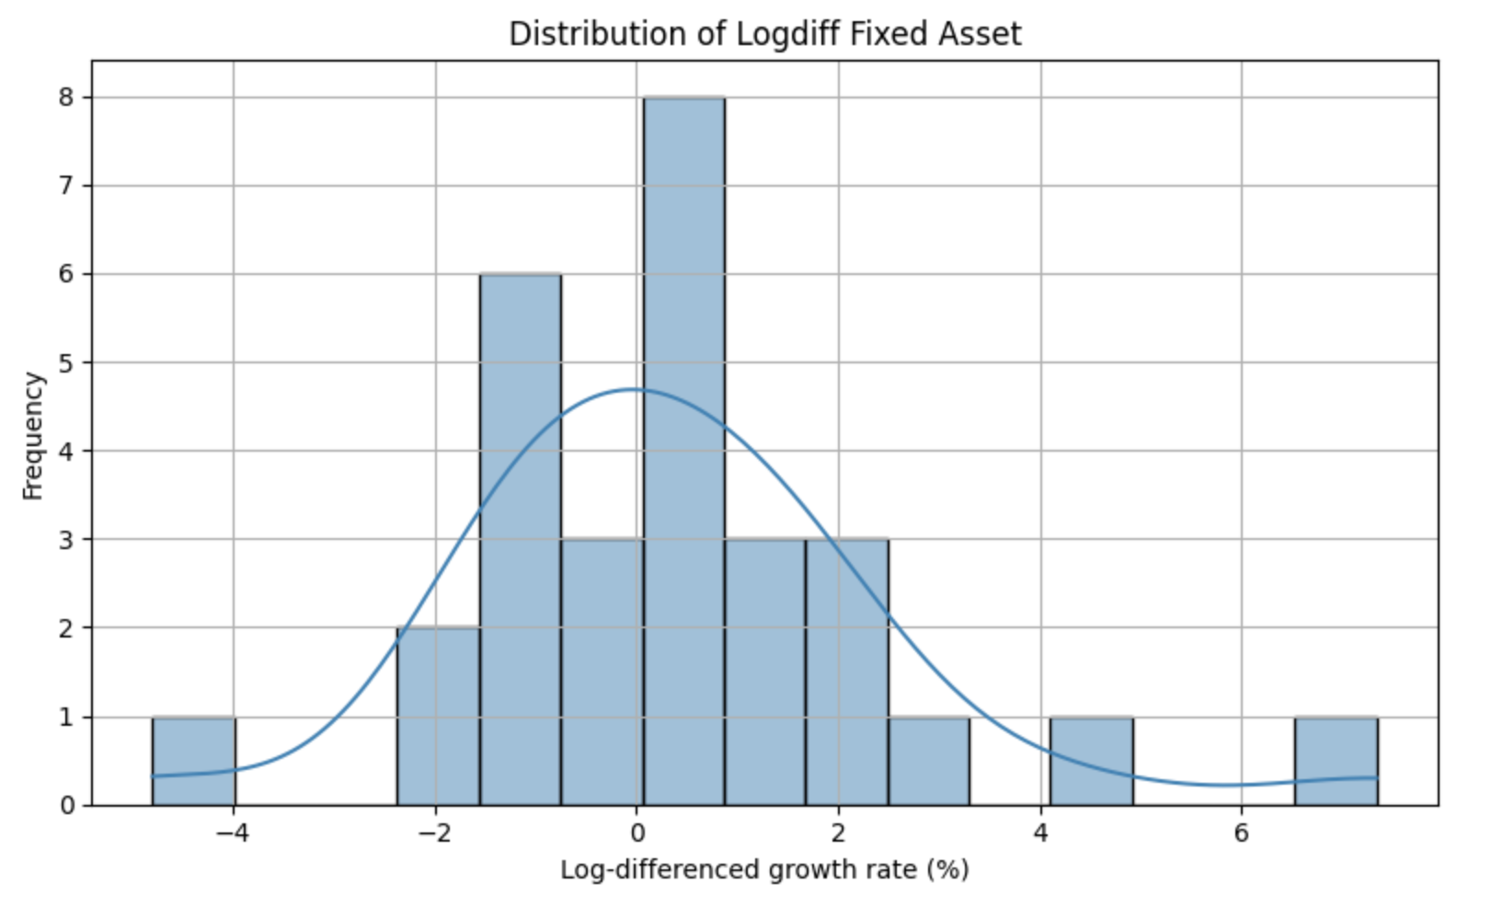
Visualization Japan
Growth Rate of Log-Differenced

Slide 29
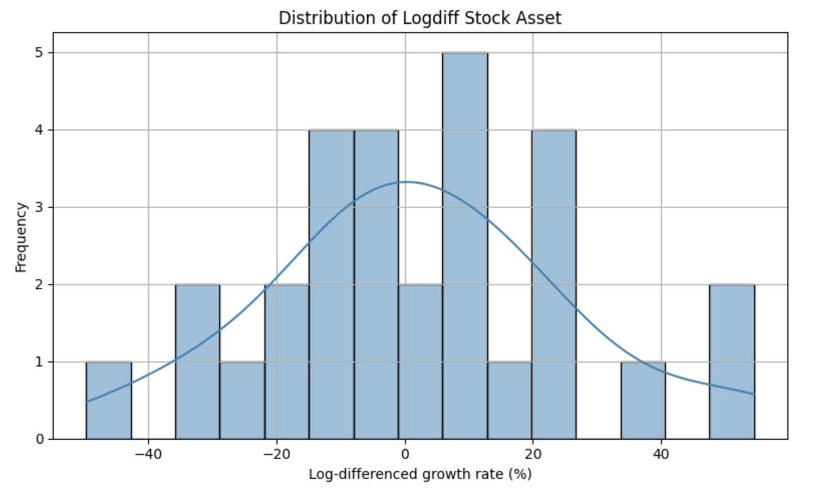
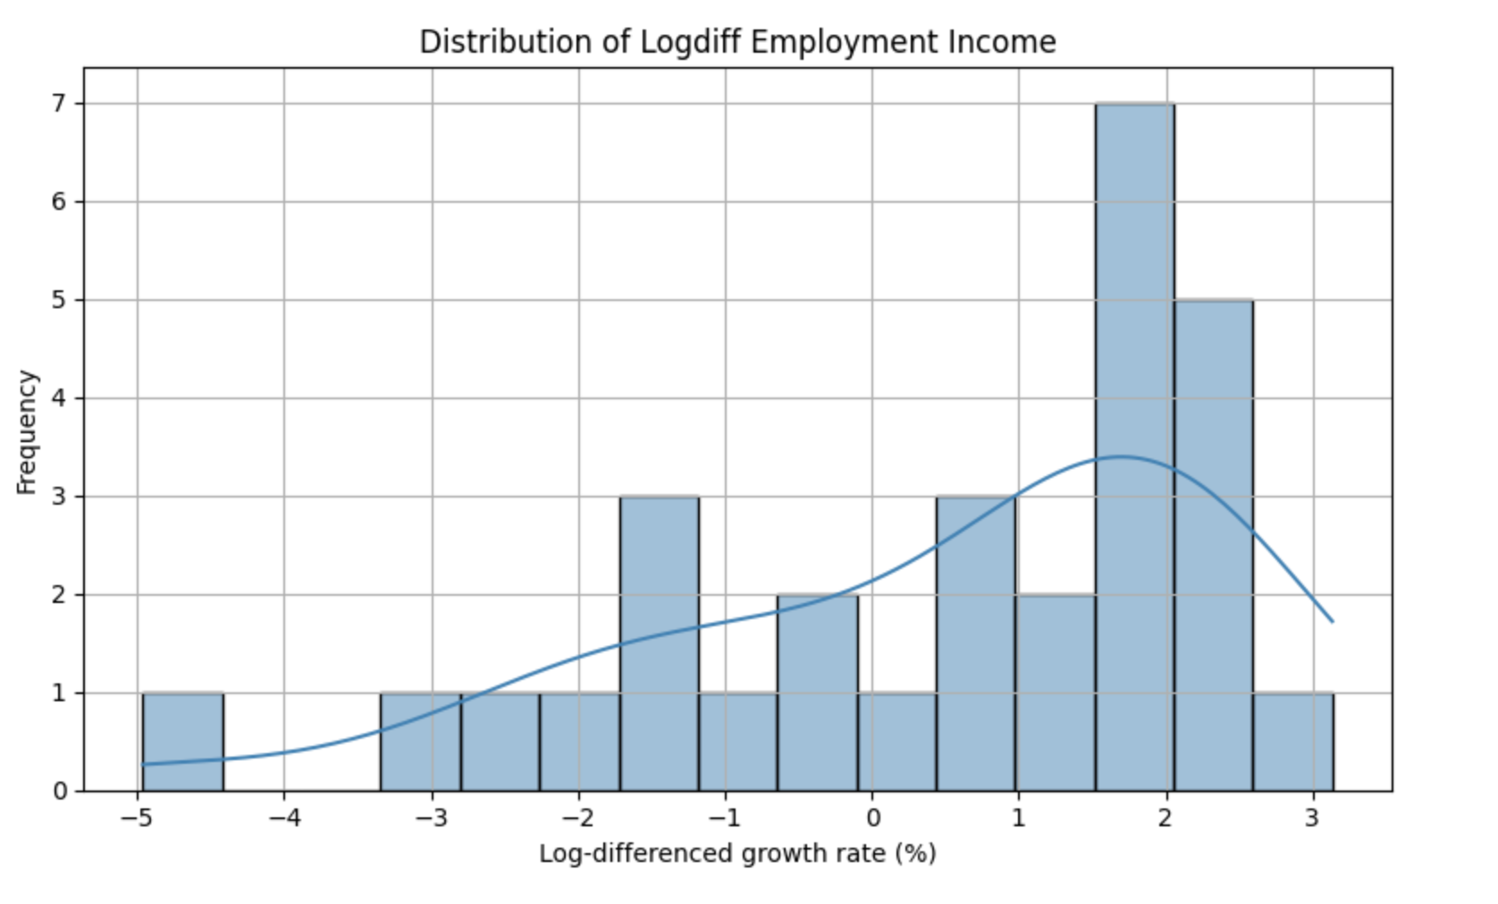
Visualization Japan
Growth Rate of Log-Differenced

Slide 30
Visualization Japan
Growth Rate of Log-Differenced
Household Consumption:occasional years of stronger positive growth, but overall variability is low.
Fixed Asset:housing-related wealth changes are gradual and stable over time.
Stock Asset:the high volatility of financial assets.
Employment Income:stable, incremental increases in labor income, consistent with macroeconomic trends in wages.

Slide 31
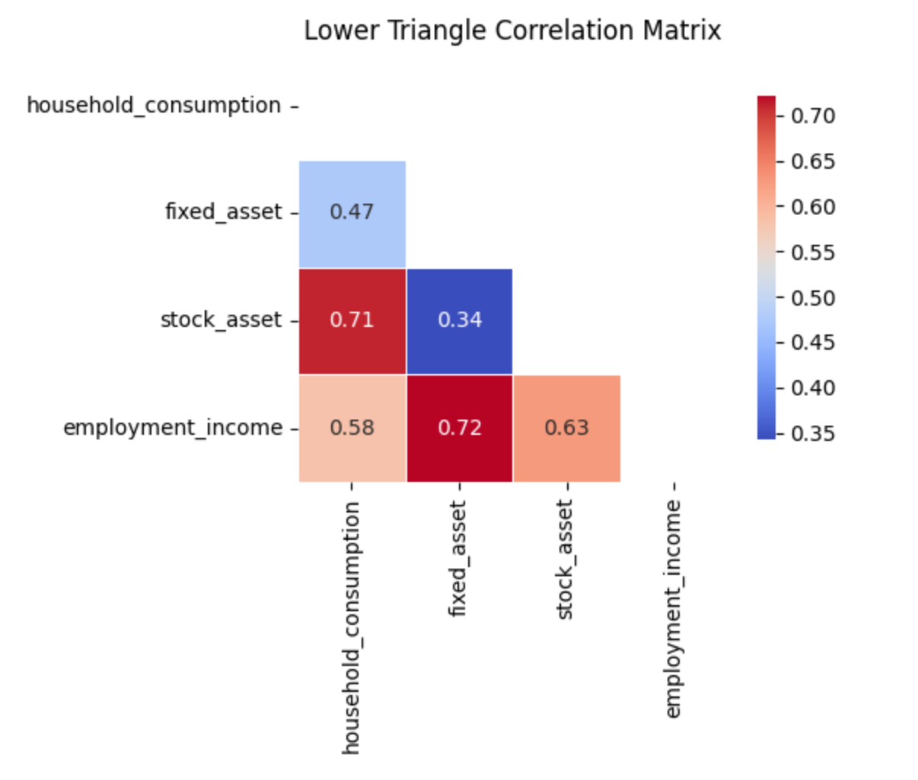
Visualization Japan
Scatter Plot

Slide 32
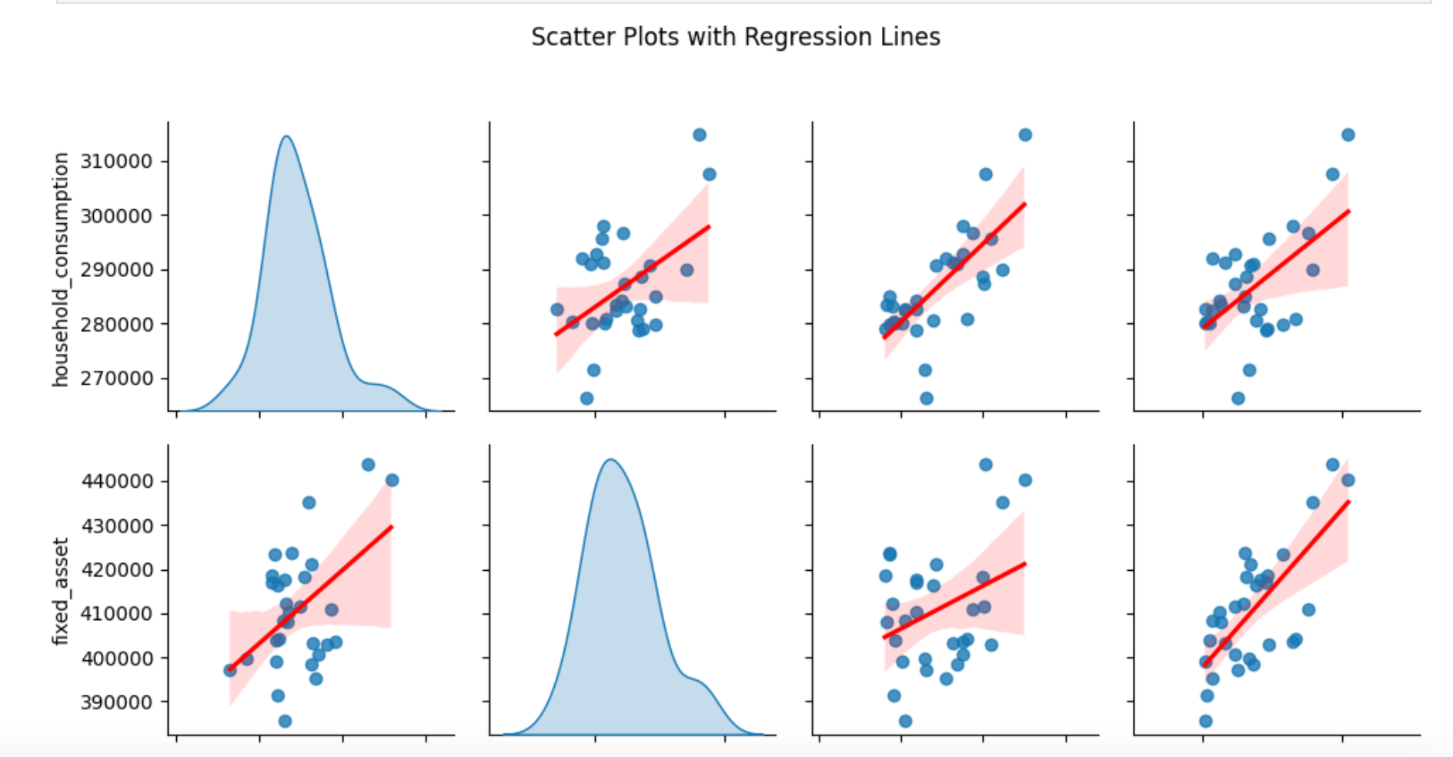
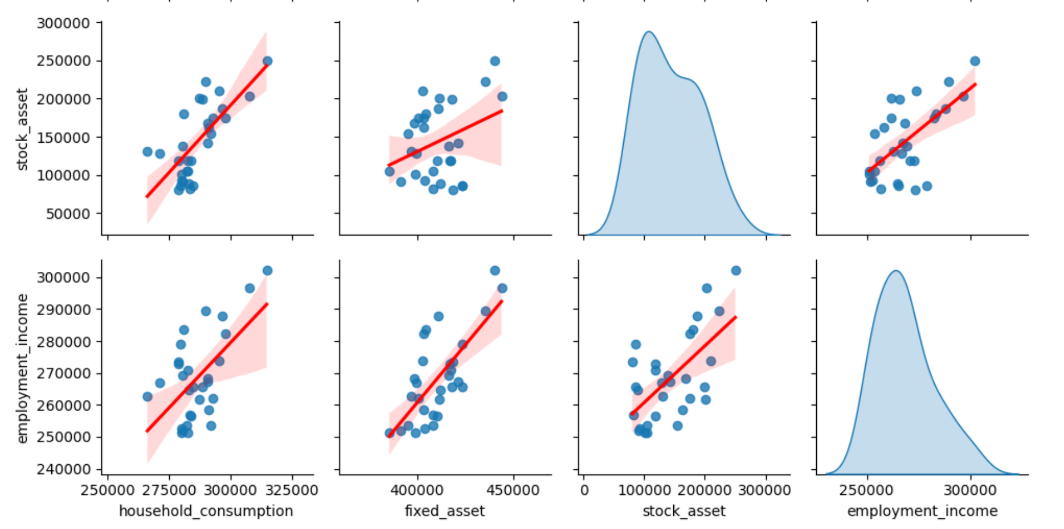
Visualization Japan
Scatter Plot

Slide 33
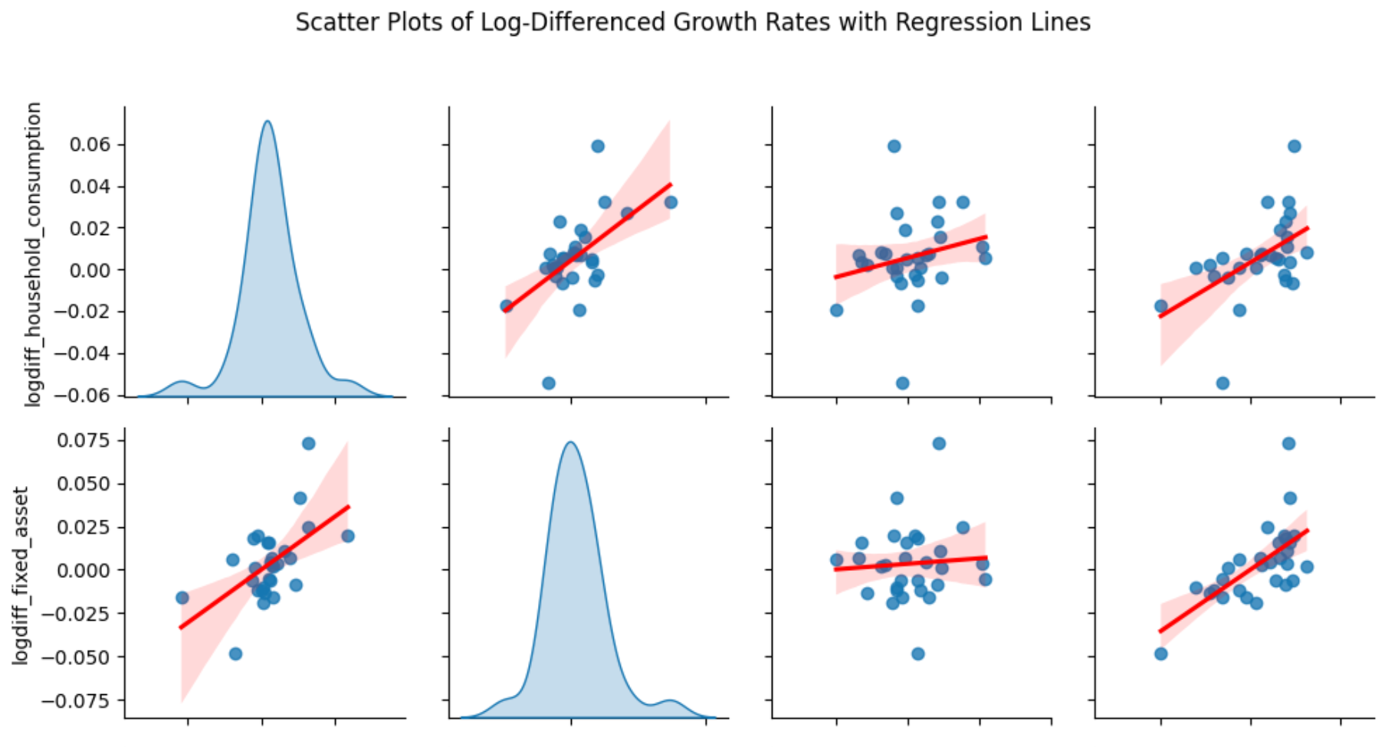
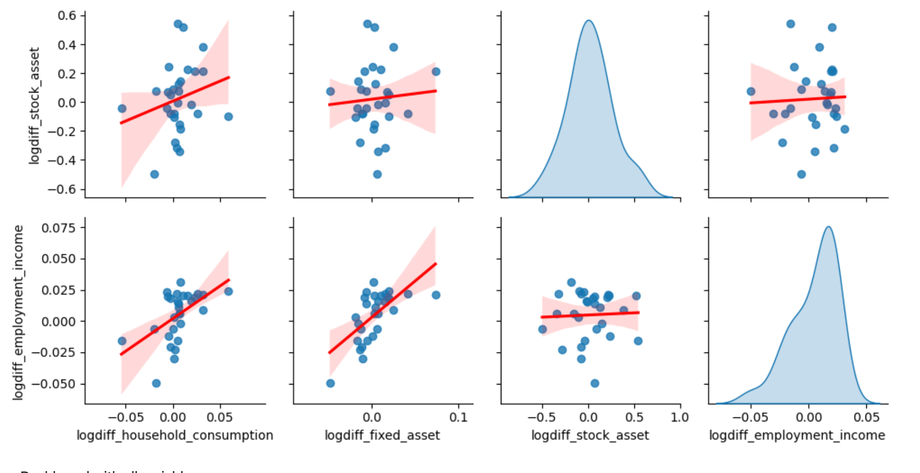
Visualization Japan
Log

Slide 34
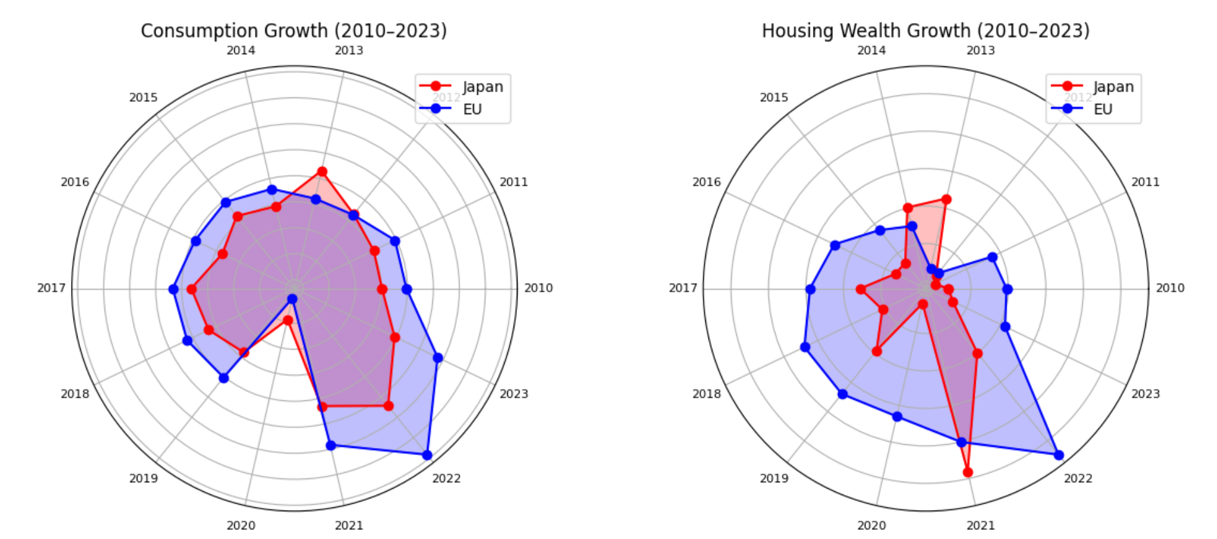
Comparison between Japan and EU

Slide 35
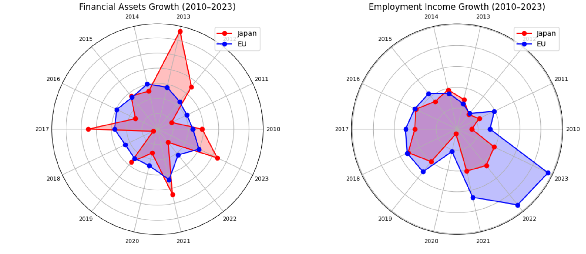
Comparison between Japan and EU

Slide 36
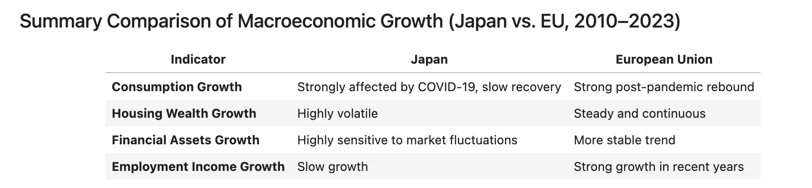
Comparison between Japan and EU

Slide 37
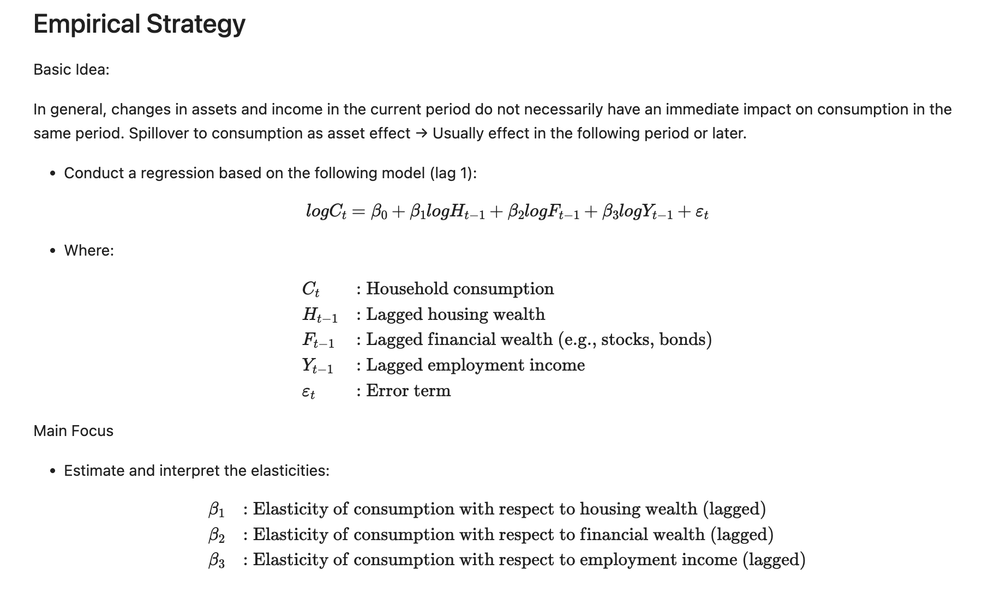
Regression

Slide 38
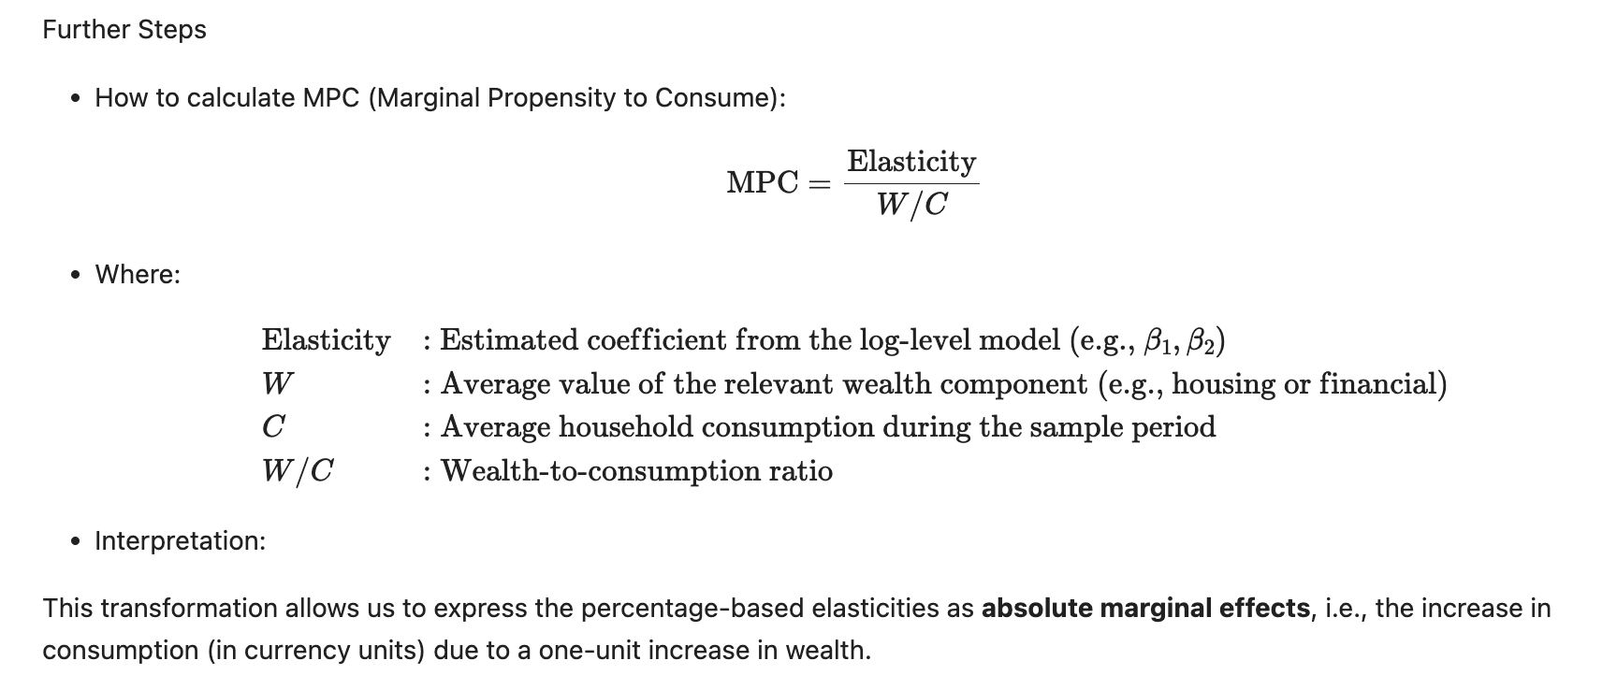
Regression

Slide 39
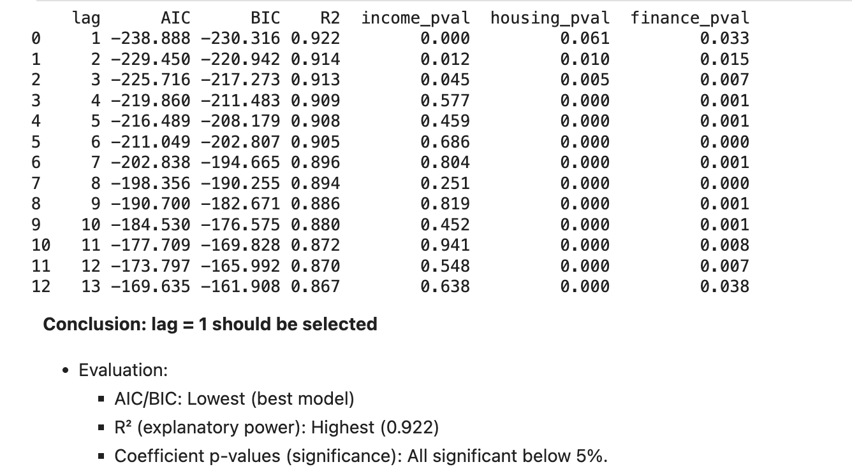
Regression Eu
Modeling of Long-run (log)

Slide 40
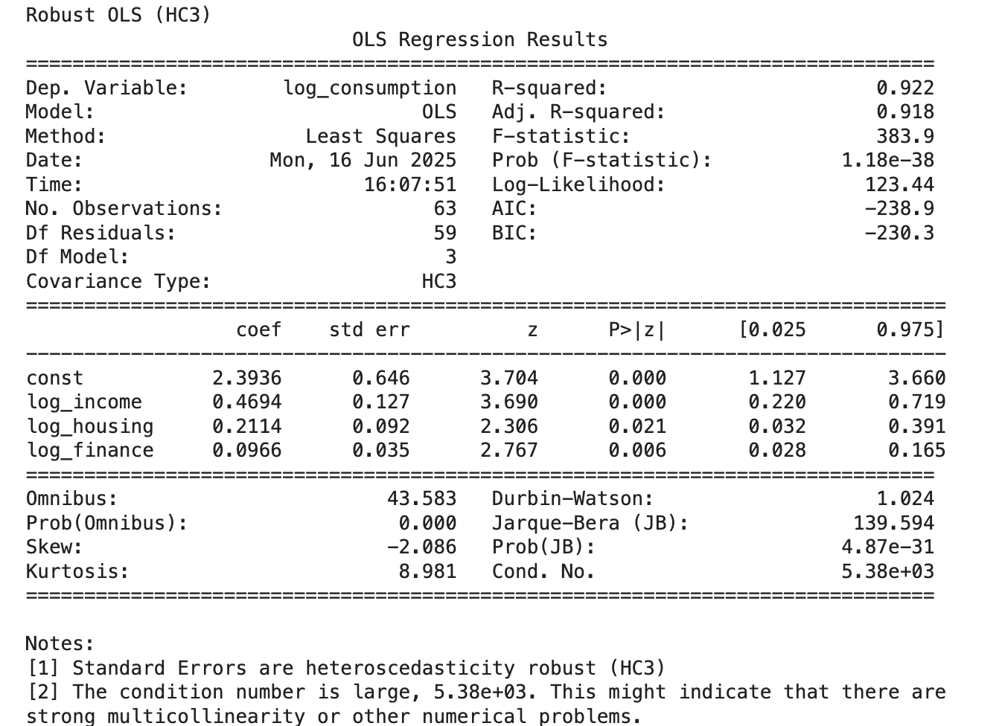
Regression Eu
Modeling of Long-run (log)

Slide 41
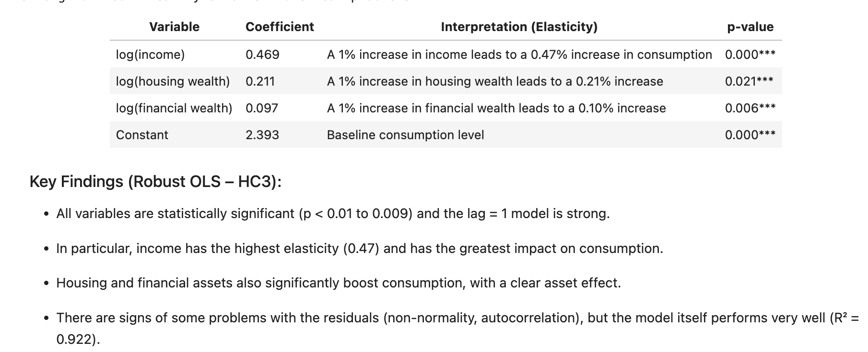
Regression Eu

Slide 42
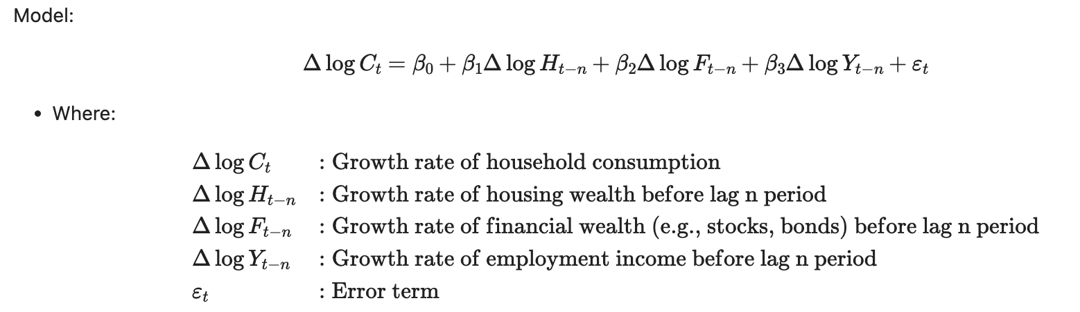
Regression Eu
Modeling of Short-run (log-diff)

Slide 43
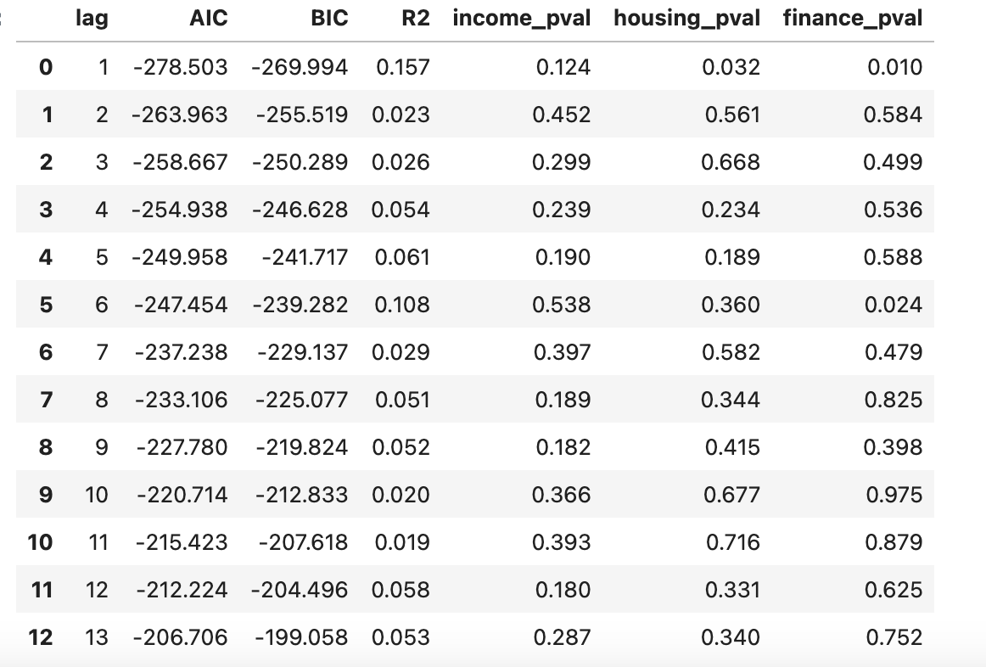
Regression Eu

Slide 44
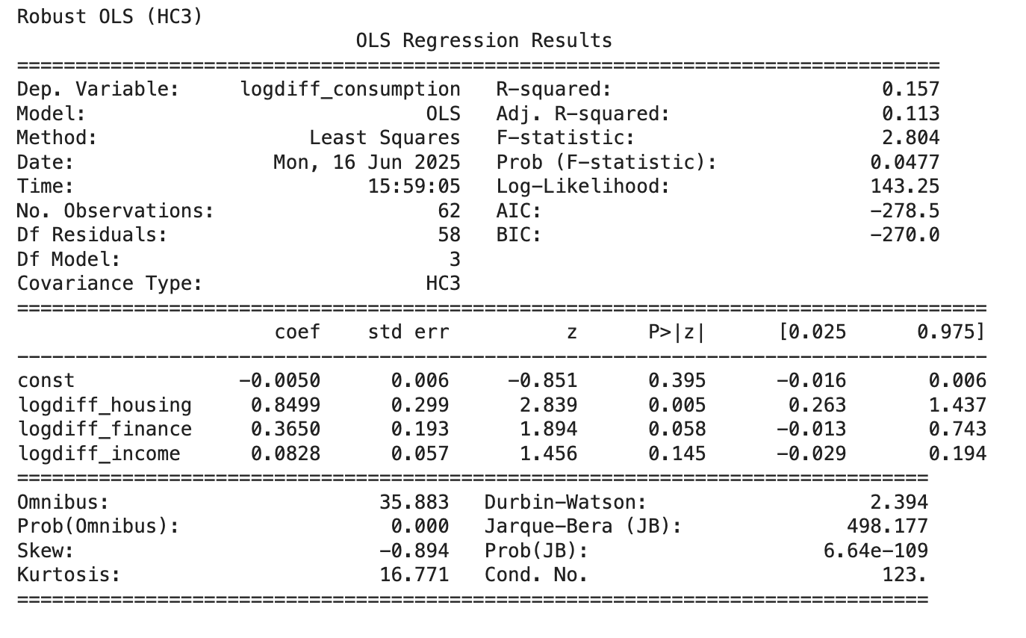
Regression Eu

Slide 45
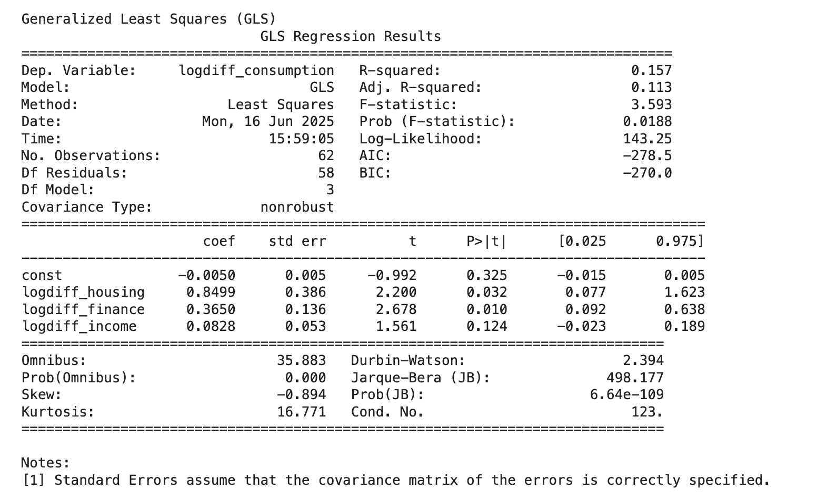
Regression Eu

Slide 46
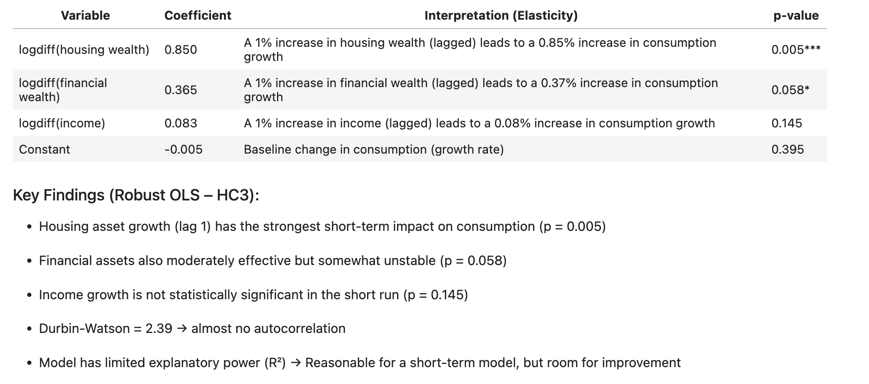
Regression Eu

Slide 47
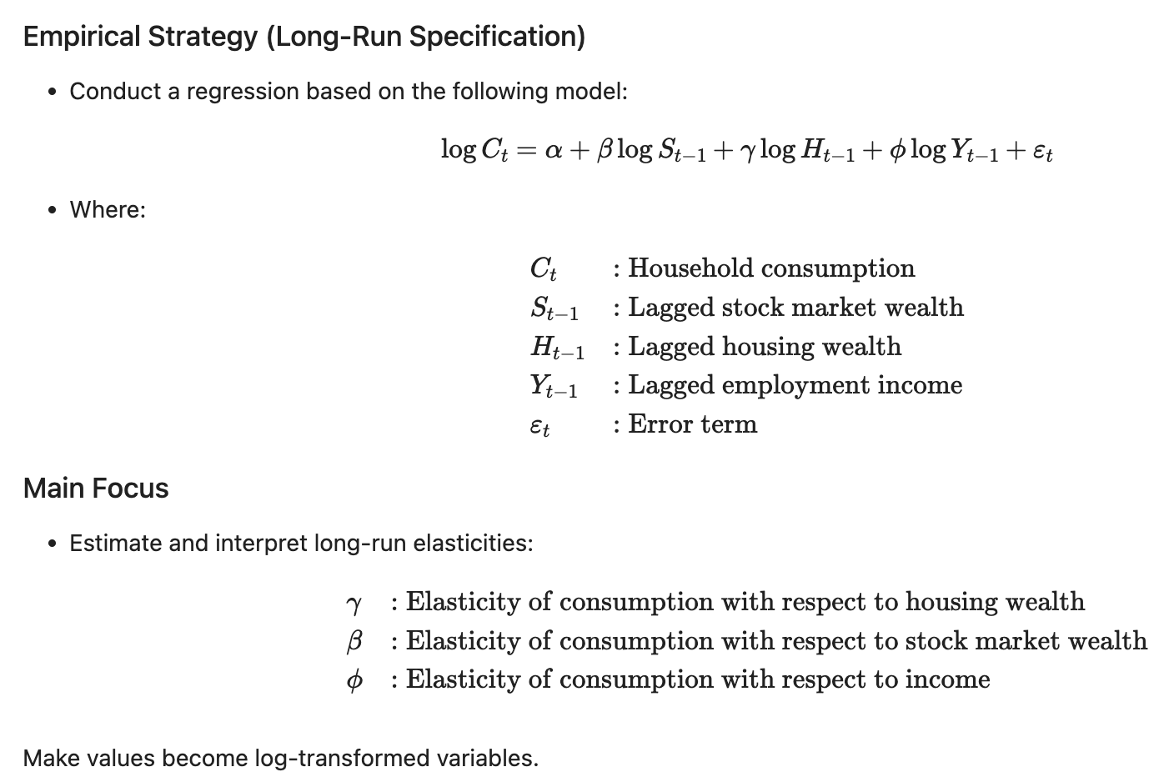
Regression Japan
Modeling of Long-run

Slide 48


Regression Japan

Slide 49

Regression Japan

Slide 50

Regression Japan

Slide 51

Regression Japan

Slide 52

Regression Japan

Slide 53

Regression Japan
Modeling of Short-run

Slide 54


Regression Japan

Slide 55

Regression Japan

Slide 56

Regression Japan

Slide 57


Regression Japan

Slide 58

Regression Japan

Slide 59

Regression Japan
Regression with Lagged Dependent Variable (AR(1) Model)

Slide 60

Finding and Summary

Slide 61

Finding and Summary

Slide 62

Finding and Summary

Slide 63
Finding and Summary
EU:
Household consumption exhibits a steady upward trend over time, closely tracking the rise in employment income and housing wealth.
A sharp decline in 2020, followed by a swift rebound, reflects the consumption shock caused by the COVID-19 pandemic and subsequent recovery.
In the long-run model:
Employment income, housing wealth, and financial assets are all positively and significantly associated with household consumption.
Among these, income has the largest and most statistically robust effect, indicating a strong long-run income-consumption linkage.
The long-run marginal propensity to consume (MPC) out of income is notably higher than that from either form of wealth.
In the short-run model:
Only housing wealth growth is significantly correlated with changes in consumption.
Changes in income and financial wealth do not exhibit significant short-term impacts on consumption growth.

Slide 64
Finding and Summary
Japan:
In the short-run model, stock market wealth (financial assets) has a statistically significant positive effect on household consumption, suggesting capital gains may directly influence consumer behavior.
Although housing wealth has a relatively larger coefficient, it is not statistically significant, implying that short-run consumption is less responsive to real estate fluctuations.
Employment income shows no significant short-run effect, possibly reflecting Japan’s stable and slowly adjusting wage system.
The short-run MPC from financial wealth is larger than that from income, indicating a stronger sensitivity of consumption to asset changes in the Japanese context.

Slide 65
Conclusion
Does household consume more when their wealth increases?
For EU, yes. They have Strong Long-Run Relationship
For Japan, Partially. They have Short-Run Sensitivity to Financial Wealth.

Slide 66
Conclusion
In the EU, household consumption increases with household wealth in the long run, especially with stable income and rising real estate and financial asset values.
In Japan, short-term consumption responds mainly to financial wealth, not housing or income.

Slide 67
References
1 Wealth and Consumption ,Diego May, Gabriela Nodari and Daniel Rees, 2019
URL:https://www.rba.gov.au/publications/bulletin/2019/mar/pdf/wealth-and-consumption.pdf
2 THE HOUSING WEALTH EFFECT:THE CRUCIAL ROLES OF DEMOGRAPHICS, WEALTH DISTRIBUTION AND WEALTH SHARES, Charles W. Calomiris, Stanley D. Longhofer, William Miles, 2012
URL: https://www.nber.org/system/files/working_papers/w17740/w17740.pdf
3. Housing Wealth Effects in Japan: Evidence Based on Household Micro Data, Masahiro Horia and Takeshi Niizeki
URL: https://www.rieti.go.jp/en/events/171214/pdf/1-2_hori_paper.pdf
4 Wealth effects on consumption evidence from the euro area, Ricardo M. Sousa
URL: https://www.ecb.europa.eu/pub/pdf/scpwps/ecbwp1050.pdf
5 WEALTH EFFECTS AND MACROECONOMIC DYNAMICS, Daniel Cooper, Karen Dynan,2014
URL: https://doi.org/10.1111/joes.12090

Slide 68
References
6 Housing Wealth, Financial Wealth and Consumption in China, Jie Chen, Feng Guo, Aiyong Zhu
URL: https://doi.org/10.1111/j.1749-124X.2009.01150.x
7 How does housing wealth affect household consumption? Evidence from macro-data with special implications for China, C. Li, Y. Zhang
URL: https://doi.org/10.1016/j.chieco.2021.101655
8 COMPARING WEALTH EFFECTS:THE STOCK MARKET VERSUS THE HOUSING MARKET, Karl E. Case, John M. Quigley, Robert J. Shiller,2001
URL: https://www.nber.org/system/files/working_papers/w8606/w8606.pdf
9 Household Wealth in China, Y. Xie, Y. Jin, Chin Sociol Rev. 2015; 47(3): 203–229.
doi: 10.1080/21620555.2015.1032158
10 Analyzing the Effects of Financial and Housing Wealth on Consumption using Micro Data, Carlos Caceres, 2019

